Slide 1

The ABC's of Grade One
Welcome to Our Class!
Notes:
http://www.teacherspayteachers.com/Store/Young-And-Lively-Kindergarten

Slide 2

Welcome
Bienvenue Welcome to class 1/2C! I am very thrilled to have your child in my class this year. I am looking forward to an exciting year full of new adventures and discoveries. In the classroom my main goal is to make each and every child feel comfortable and develop a love of learning. I strongly believe that once a child feels comfortable they are able to take risks and reach their full potential while developing a positive self-image.

Slide 3
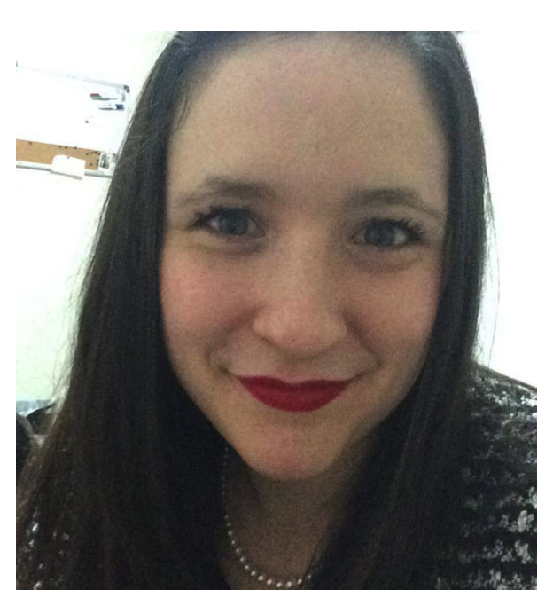
About me…
-Photo
-Work
-My family
-My schooling
-1/2 combined

Slide 4

Agenda-check and sign! Allergies-nut-safe Attendance-why?
Birthdays-invitations and treats
Book Orders-scholastics

Slide 5

Communication-where? Curriculum
Directory-friends Drop off & Dismissal -times/expectations

Slide 6

email
Field trips - volunteers French flashcards- website!!
Fire drills are required at least twice a year..
Grenouilles-what are they?

Slide 7

Homework-10-15 minutes Homework folder-check me!! HRTS
Illness-eww!

Slide 8

Late arrivals Library books- Tuesday - bag Lunch-12:50pm

Slide 9

Medical concerns

Slide 10

Payments-online, ziploc Printing-top to bottom

Slide 11

Reading program-what to do! -book bag -read more than once -who reads, how to read! Recess Agreement-at home.
Schedule Sight Words-what’s that!!
Technology-why? Tying Shoes-…

Slide 12

Volunteers-criminal record & child welfare. Volunteer handbook
Waterbottles- water only

Slide 13

eXtra clothes-puddles
You…
ZzZzZz...

Slide 14

“Everybody’s a teacher, everybody’s a student.”

Slide 15

My promise…

